Slide 1

Europe policy context; and demand, supply, storage and transmission
Mark Barrett
UCL Energy Institute
University College London
International Renewable Electricity
– an essential system?
UCL Institute of Child Health
London
Friday 21st May 2010

Slide 2
OBJECTIVES OF STRATEGY
SOCIAL, ECONOMIC, POLITICAL
Meet objectives at least cost with social equity
Avoid irreversible, risky technologies
ENERGY SECURITY
EU ; 20 % share of renewable energy by 2020
UK ; 15% of energy from renewables by 2020
  => ~35% renewable electricity?
renewable transport fuels: 5% of by 2010, 10% by 2020
ENVIRONMENT
Global warming:
  World: >60% GHG emission by 2050
  Europe: 20/30% GHG reduction 1990-2020
  UK: Reduction from 1990: ~30% by 2020, 60-80% by 2050
  Rich countries: >95% reduction by 2050
Other: Air pollution, nuclear waste etc.

Slide 3
SEEScen sample: EU25 CO2 : variant scenarios
Over 2005-2050, behavioural change reduces integrated CO2 by 33% more than technology, and faster
40% reduction
New nuclear
Maximum behaviour
No new nuclear
Maximum technology
No new nuclear
Maximum technology and behaviour
No new nuclear

Slide 4
The role of electricity
To meet targets require efficiency and renewable energy
Renewable electricity and heat for ‘easy’ stationary sectors – buildings, industry, etc.
Allow some carbon emission from hard sectors - aviation, shipping , etc.
A large fraction of low cost renewable energy produces electricity
To integrate renewables, what is the least cost combination?
Load management?
Storage?
Transmission?
Dispatchable generation?

Slide 5
UK dwellings scenario
Energy deliveries for heating
(note elec heat pumps make delivered<useful heat)
Space and water useful heat demand
Energy deliveries for all purposes
CO2 emission with electricity carbon intensity reduction

Slide 6
UK dwellings scenario : monthly heat demand
How to model temporal and spatial diversity across building stocks?
With reduced annual space heating:
Space heat demand has lower load factor (average/maximum) because heating season shortened
Overall heat demand load factor changes little because of water heating fraction
Note: these are monthly factors

Slide 7
UK dwellings scenario : diurnal space and water heat demand
2005
2050
This is an example of heat demand, net of incidental solar and internal gains, without any storage
How will heat demand vary by house type?
Again, how to model temporal and spatial diversity across building stocks?

Slide 8
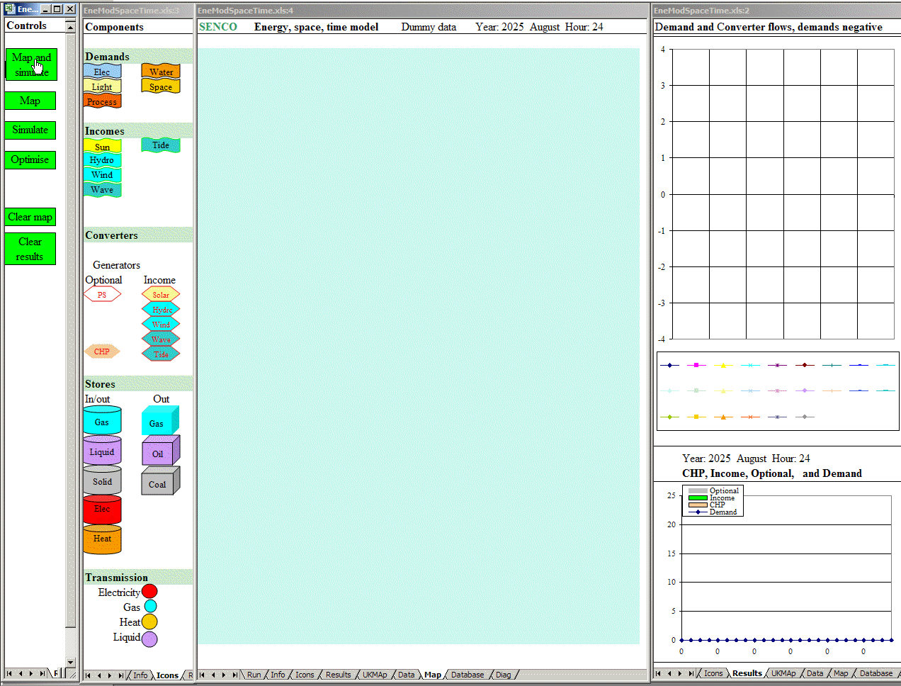
UK energy, space and time : animated

Slide 9
The fractal energy, space and time problem
What is the best configuration?
What capacities?
Where to locate technologies?
Renewables
Storage
Transmission
Dispatchable generation

Slide 10
Electricity system design with variable sources : storage
Parameters
  input, output and stored energy forms (electricity, chemical, kinetic, heat, ..)
  storage capacity (J)
  input and output power (W)
Technologies
  Charge/discharge connections
  Maximum charge/discharge cycles
  Energy/power per weight/volume
  Safety
  Cost
Types and system location
  end use storage
    embedded in end use technologies (building thermal mass, refrigerators)
    purpose built (hot water tank, solid heat storage heater)
    vehicle batteries
  local /neighbourhood storage
    batteries/electrolyte recharging garage for refuelling electric vehicles
    heat stores in DH and CHP systems
  system storage
    pumped storage or other (compressed air, flywheels, etc.)

Slide 11
Electricity system design with variable sources : generation
Generation
Renewable
  resource intensity variation in space and time of hydro, wind, wave, solar, tidal, biomass
  technology output variation a function of resource variation and design
    minimum/ maximum resource intensity for operation
    efficiency variation with resource intensity
  manipulation of technology output variation
    spatial distribution of wind, wave, solar, tidal energy collectors
    technology design; solar collection orientation, tidal scheme configuration
CHP
  heat load size and temporal variation
  CHP technology; variable heat: electricity ratio
Back-up; biomass, fossil, nuclear
Regional and international transmission linkage
System operation
  prediction in time and space of demand and supply
  control of demand, storage and supply technologies

Slide 12
Energy systems : multi-fuelling
Multi-fuelling of demands
Some demands can be met by more than one fuel which can have benefits and disbenefits.
For example:
water heating might be met by a mix of solar, gas and electric heat.
  solar heating and solar electricity generation are highly correlated
hybrid electric/liquid fuelled vehicles.
  when renewable electricity supply is low, a greater fraction of vehicle energy comes from liquid fuel.
Multi-fuelling has these disbenefits:
capital costs are high because several supply technologies are required
the net demand on the auxiliary fuel (e.g. gas) becomes peaky and problematic and therefore an easily stored fuel such as biomass, coal or oil might be advantageous

Slide 13
Energy systems : operational issues
The design and operation of systems depends on the reliability with which demands and supplies can be predicted over different time scales, from minutes to months, and the sophistication of the control of demand and supply technologies. As the UK electricity system becomes increasingly integrated with the European system and systems further afield, the design and operation of the systems will become more complex.
Prediction
The accurate prediction of demands and supplies will become more critical, mainly because of the larger variable renewable component of supply and its consequences for the operational management of demands, storage and trade. However, prediction will improve with the refinement of weather and other data and of simulation models.
  weather forecasting will become more precise
  energy efficiency and demand management reduces the less predictable, weather dependent loads such space heating and lighting
  demand prediction will become more accurate as models improve
  predicting outputs from variable sources will become more accurate
Technology control
Communications and information processing technologies are already adequate for the very precise control of demand technologies, generators and storage.

Slide 14
EleServe : matching demand to supply with load management
The EleServe model has these components:
Electricity demand
disaggregated into segments across sectors and end uses
each segment with
  a temporal profile
  load management characteristics
Electricity supply
each renewable source with own temporal profile
heat related CHP generation with its own temporal profile
optional thermal generators characterised by energy costs at full and part load, and for energy and economic costs of spinning reserve, and heating up plants to bring on stream
trade and system storage
Operational control
load management: demands are moved if the net cost of a move is negative, accounting for differences in marginal supply costs, energy losses and other operational costs
optional units brought on line to minimise diurnal costs

Slide 15
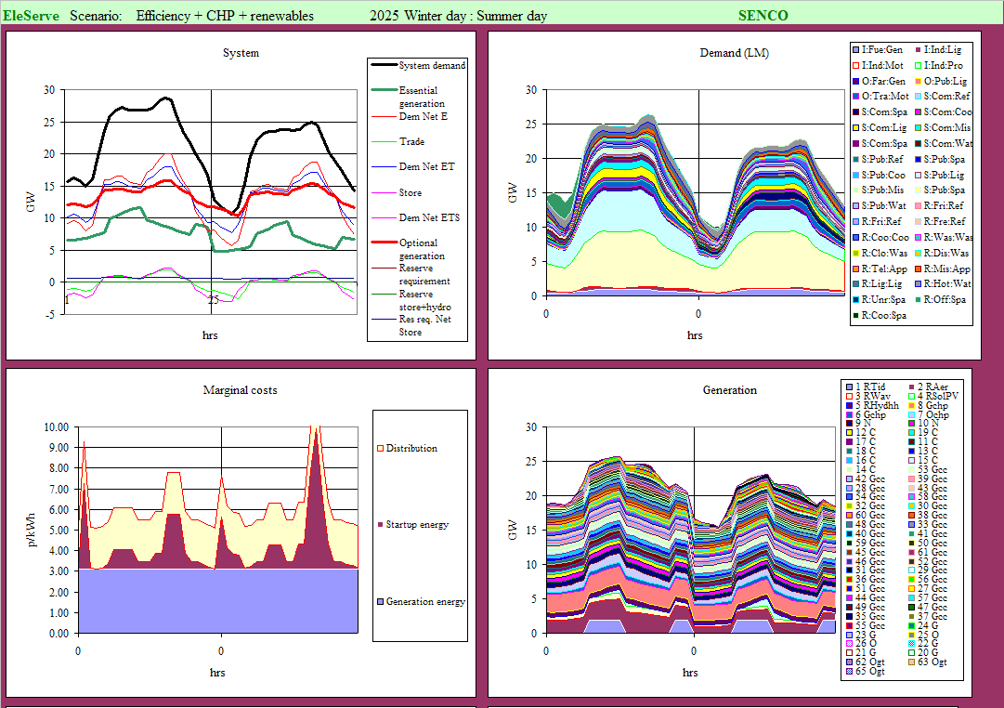
Electricity : diurnal operation without load management

Slide 16

Electricity : animated load management optimisation

Slide 17
Electricity : diurnal operation after load management

Slide 18
VarInt : Sample day : winter’s day of variable supply excess

Slide 19
VarInt : Sample day : winter’s day of variable supply deficit

Slide 20

VarInt : Day sampling : animation

Slide 21
VarInt : Optimised system : sample year
These charts show the sampled year performance of the optimised system for one set of weather.

Slide 22
International exchange
International transmission for the exchange of renewable electricity:
Reduces costs
Enhances security through mutual economic advantage and co-dependency
[Note: animation shows optimisation, not real time electricity flows.]

Slide 23
SEEScen sample: EU – elsewhere energy trade
Renewable electricity reduces finite fuel import and .provides export

Slide 24
Implementation : Past, present and future
UK
1881 Godalming public electricity
1915 600 companies, average generator capacity 3.5 MW
1926-1938 synchronous AC grid
1949-65 275-400 kV
Europe
1914 Star of Laufenburg , Germany-Switzerland
1920 Idea of European grid
1958 Germany-Switzerland-France
2010 34 countries connected
Asia
Unified Power System of Russia (UPS), Integrated Power System (IPS) of 10 Eurasian (CIS) countries
Europe-Asia
IPS/UPS synchronous connected with the Baltic countries; 900 MW HVDC connection to Finland
Russia-EU are considering unifying grids to form a single synchronous grid spanning 13 time zones.
Europe-Africa
Spain - Morocco

Slide 25
IMPLEMENTATION EXAMPLE:
EU ENERGY SECURITY AND SOLIDARITY ACTION PLAN
SECOND STRATEGIC ENERGY REVIEW
OBJECTIVES
Infrastructure needs and the diversification of energy supplies
External energy relations
Oil and gas stocks and crisis response mechanisms
Energy efficiency
Making the best use of the EU’s indigenous energy resources
TRANSMISSION to include development of:
a Baltic interconnection plan
Electricity and gas interconnections within Central and South-East Europe, supporting the national energy regulators and Transmission System Operators;
a blueprint for a North Sea grid, interconnecting national electricity grids and plugging in planned offshore wind projects.
INSTRUMENT
EU Energy Security and Infrastructure Instrument to replace Trans-European Energy Networks (TEN-E)
to ensure the effective use and evolution of the EU's external policy and financial instruments to contribute to achieving these objectives
http://ec.europa.eu/energy/strategies/2008/2008_11_ser2_en.htm

Slide 26
1: EXAMPLES OF EUROPEAN SUPERGRID IMPLEMENTATION POLICY
EUROPEAN COMMISSION
GREEN PAPER: TOWARDS A SECURE, SUSTAINABLE AND COMPETITIVE EUROPEAN ENERGY NETWORK. {SEC(2008)2869}
http://eur-lex.europa.eu/LexUriServ/LexUriServ.do?uri=COM:2008:0782:FIN:EN:DOC
ON THE IMPLEMENTATION OF THE TRANS-EUROPEAN ENERGY NETWORKS PROGRAMME IN THE PERIOD 2002-2006. http://ec.europa.eu/energy/strategies/2008/doc/2008_11_ser2/ten_e_report_implementation_annexe.pdf
Brussels, 13.11.2008 COM(2008) 768 final. COMMUNICATION FROM THE COMMISSION TO THE EUROPEAN PARLIAMENT, THE COUNCIL, THE EUROPEAN ECONOMIC AND SOCIAL COMMITTEE AND THE COMMITTEE OF THE REGIONS. Offshore Wind Energy: Action needed to deliver on the Energy Policy Objectives for 2020 and beyond
COMMUNICATION FROM THE COMMISSION TO THE EUROPEAN PARLIAMENT, THE COUNCIL, THE EUROPEAN ECONOMIC AND SOCIAL COMMITTEE AND THE COMMITTEE OF THE REGIONS Second Strategic Energy Review. AN EU ENERGY SECURITY AND SOLIDARITY ACTION PLAN. {SEC(2008) 2870} {SEC(2008) 2871} {SEC(2008) 2872}
http://eur-lex.europa.eu/LexUriServ/LexUriServ.do?uri=COM:2008:0781:FIN:EN:DOC
IP/08/1696. Brussels, 13 November 2008. Securing your energy future: Commission presents energy security, solidarity and efficiency proposals
http://europa.eu/rapid/pressReleasesAction.do?reference=IP/08/1696&format=DOC&aged=0&language=EN&guiLanguage=en

Slide 27
2: EXAMPLES OF EUROPEAN SUPERGRID IMPLEMENTATION POLICY
GOVERNMENT
N orth Seas Countries Offshore Grid Initiative (NSCOGI). 9 governments: Germany, France, Belgium, the Netherlands, Luxembourg, Denmark, Sweden and Ireland and the UK
OTHER
Friends of the Supergrid (FOSG) includes 10 companies
Windspeed http://www.windspeed.eu/
Realise Grid: http://realisegrid.erse-web.it/

Slide 28
CONCLUDING REMARKS
International renewable electricity not essential, but least cost and most secure
Merely the next step from past to future
Not a technological problem
Analytical problem – cost minimisation with demand, renewables, storage, back-up and transmission
How to achieve optimal low risk development through investment and operation?
  Political arrangements
  Public planning and market mechanisms
Let us be ambitious....

Slide 29
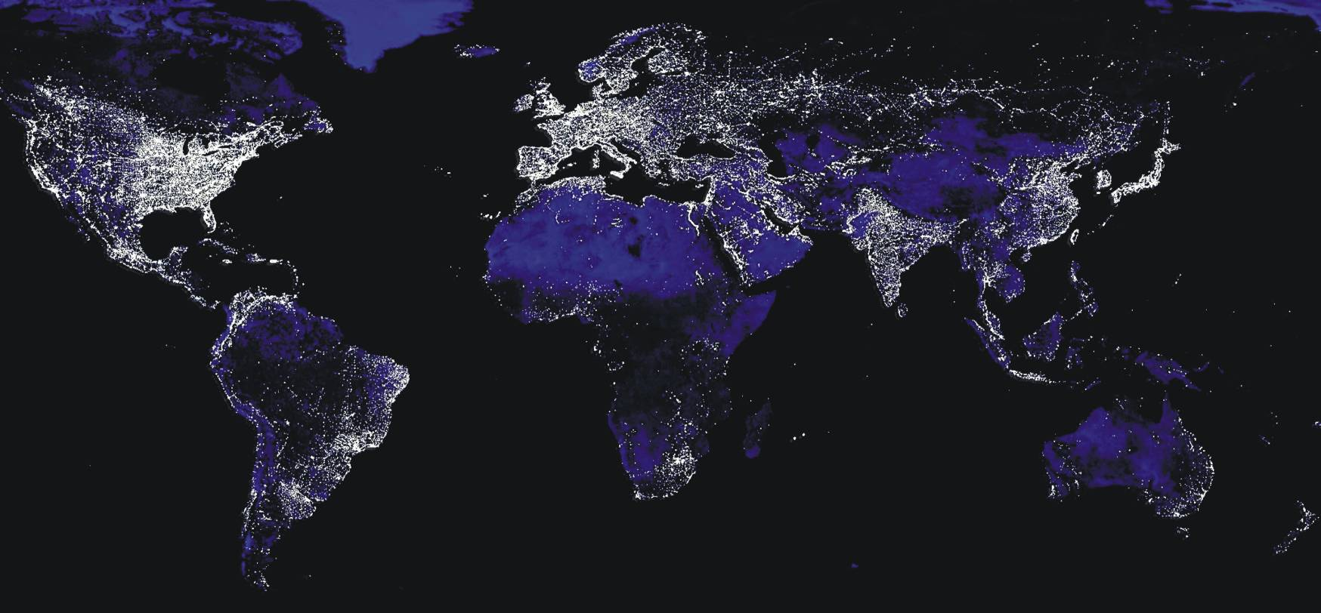
World
There are global patterns in demands and renewable supplies:
Regular diurnal and seasonal variations in demands, some climate dependent
Regular diurnal and seasonal incomes of solar energy
Predictable tidal energy income

Slide 30
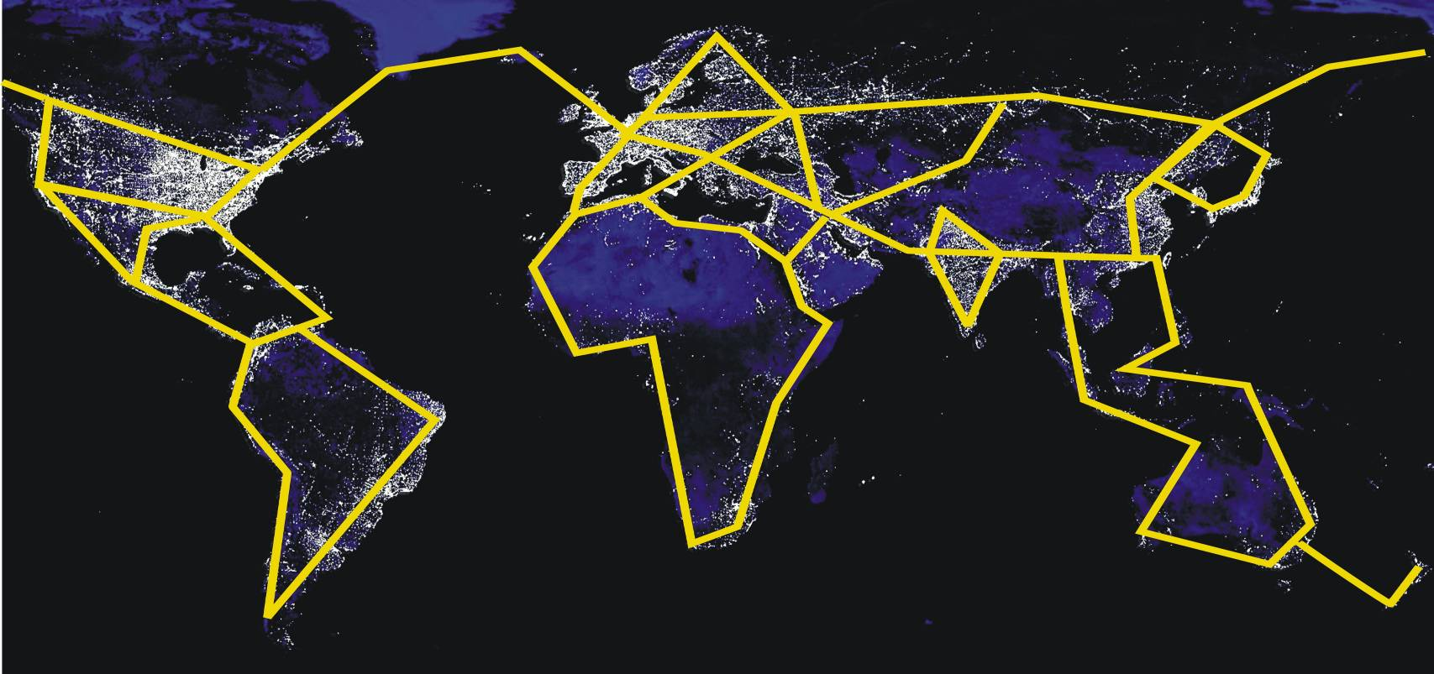
World: a global electricity transmission grid?
Should transmission be global to achieve an optimum balance between supply, transmission and storage?
Which investments are most cost efficient in reducing GHG emission? Should the UK invest in photovoltaic systems in Africa, rather than the UK? This could be done through the Clean Development Mechanism

Slide 31
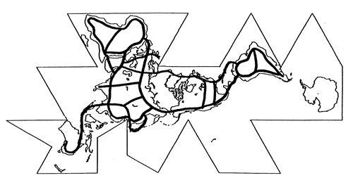
World: a global electricity transmission grid –Buckminster Fuller
Buckminster Fuller published this in 1938.
Copyright 1938, Buckminster Fuller Institute, Los Angeles. All rights reserved. The word Dymaxion and Dymaxion(TM) Map design are trademarks of the Buckminster Fuller Institute.

Slide 32
Some references
Renewable electricity system: Feasibility of a high renewable electricity system
Barrett, M. 2007, A Renewable Electricity System for the UK. In Renewable Energy and the Grid: The Challenge of Variability, Boyle, G., London: Earthscan. ISBN-13: 978-1-84407-418-1 (hardback).
http://www.cbes.ucl.ac.uk/projects/energyreview/Bartlett%20Response%20to%20Energy%20Review%20-%20electricity.pdf
http://www.bartlett.ucl.ac.uk/markbarrett/Teaching/SEE_Electricity.pptx
Barrett M, December 2007, Low Emission Energy Scenarios for the European Union, report 5785. ISBN 91-620-5785-5, ISSN 0282-7298. http://www.naturvardsverket.se/Documents/bokhandeln/620-5785-5.htm
Naturvårdsverket (Swedish environmental protection agency, SE-106 48 Stockholm www.naturvardsverket.se
Power stations: emissions and health effects
Barrett M, Holland M, April 2008, The Costs and Health Benefits of Reducing Emissions from Power Stations in Europe. Published by the Air Pollution and Climate Secretariat and the European Environmental Bureau. ISBN: 978-91-975883-2-4
ISSN: 1400-4909. http://www.airclim.org/reports/APC20_final.pdf

Slide 33
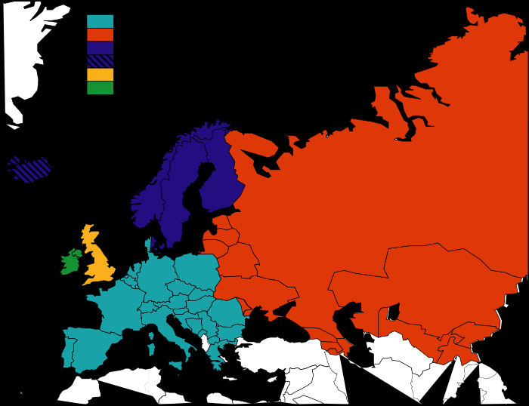
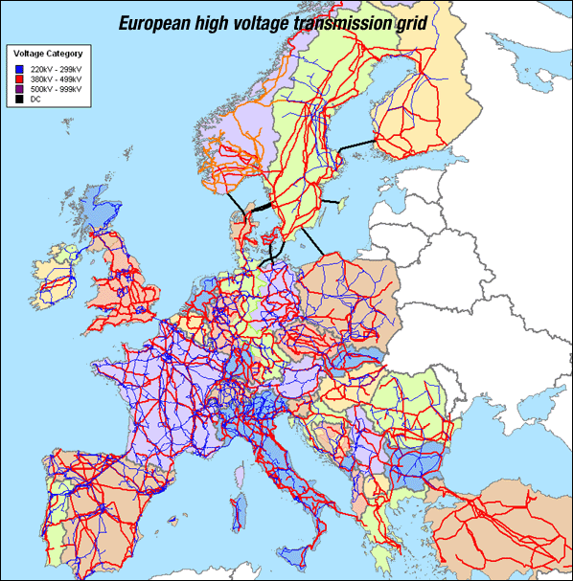
History
Unified power system of Russia (UPS)
The Integrated Power System (IPS) of Ukraine, Kazakhstan, Kyrgyzstan, Belarus, Azerbaijan, Tajikistan, Uzbekistan, Georgia, Moldova and Mongolia

Slide 34
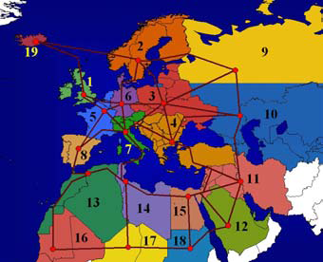
HVDC Gregor Czisch
Source: Gregor Czisch
Possible electricity supply area divided into
19 regions with schematic representation of
potential electricity transmission paths using HVDC
to the geographic population centres of the regions

Slide 35
UCTE 2004

Slide 36
Security and infrastructure: questions and challenge
What is the optimum balance?
Within infrastructure:
Transmission
Storage
Conversion capacity
Between infrastructure and other security measures:
Demand management – efficiency and load management
Renewable energy
The modelling challenge
Technical: dynamic spatiotemporal systems modelling at short time periods over many countries
Other dimensions; economic, political, environmental

